Slide 1
Fingerprints

Slide 2
Learning Objectives
Explain what dactyloscopy is
Identify the type(s) of fingerprint pattern on your own fingers

Slide 3
Dactyloscopy
Dactyloscopy is the study of fingerprint identification.

Slide 4
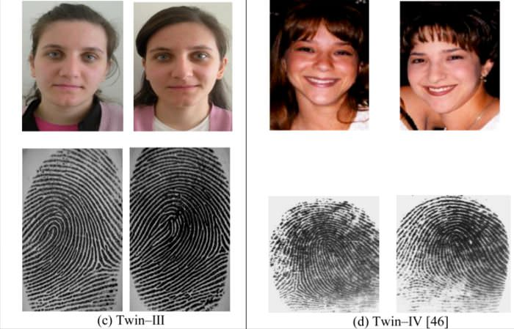
Fingerprints are Unique
No two people have the exact same fingerprint pattern (not even twins!)

Slide 5
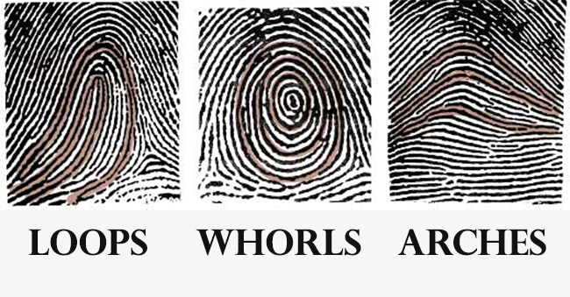
Fingerprint Types
There are 3 types of fingerprints based on their visual pattern

Slide 6
Arch
Plain Arch
Tented Arch
Arches are formed by ridges that enter on one side of the print and exit the other.

Slide 7
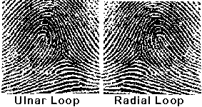
Loops
Delta
Loops have ridges that enter and leave on the same side and one delta

Slide 8
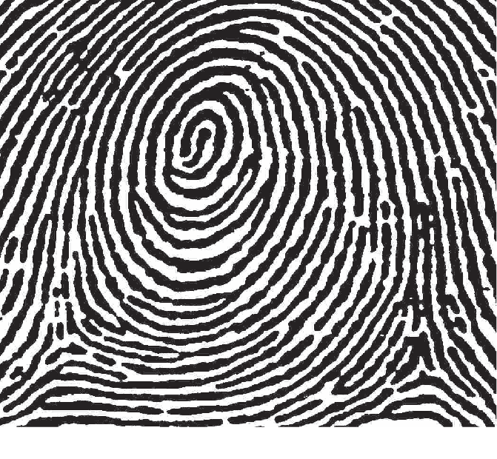
Whorls
Delta
Delta
Whorls have at least one complete circuit and two deltas

Slide 9
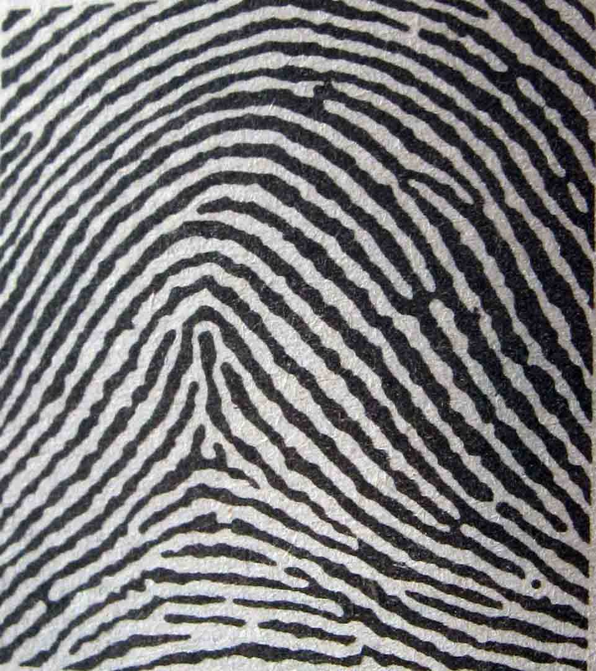
Type of Fingerprint?
Arch

Slide 10
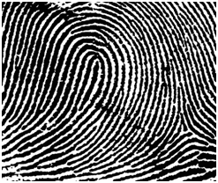
Type of Fingerprint?
Loop

Slide 11
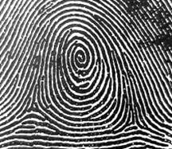
Type of Fingerprint?
Whorl

Slide 12
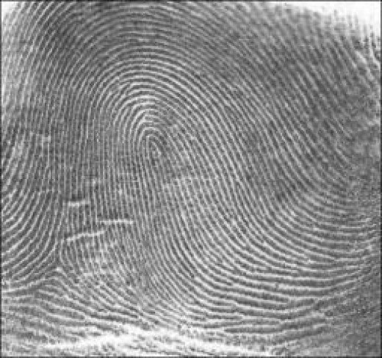
Type of Fingerprint?
Loop

Slide 13
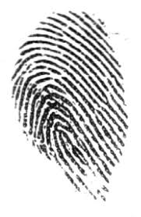
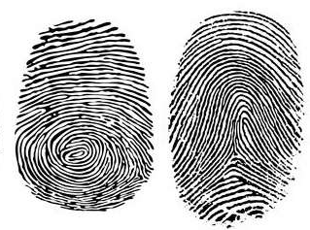
It’s Your Turn To Make A Fingerprint Panel!
Avoid partial
prints
Roll your fingers from side to side

Slide 14
YouTube Where Do Fingerprints Come from?

Slide 15
YouTube Why are Fingerprints Unique?

