Slide 1
Homeostasis

Slide 2
Learning Objectives
Explain what homeostasis is
Describe how a feedback loop functions and provide an example

Slide 3
Homeostasis
Homeostasis – the body’s ability to regulate internal conditions to remain stable and constant.

Slide 4
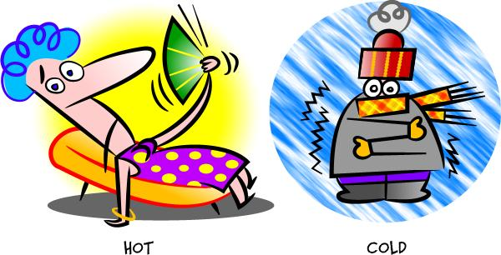
Balance
If you are too hot or too cold, your body temperature is out of balance.

Slide 5
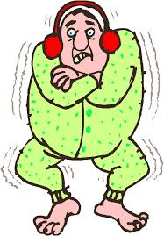
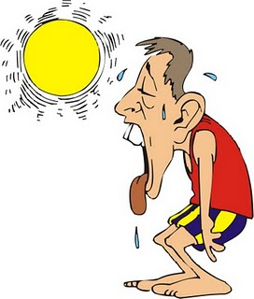
Return to Normal
Too cold:
body shivers
Too hot:
body sweats

Slide 6
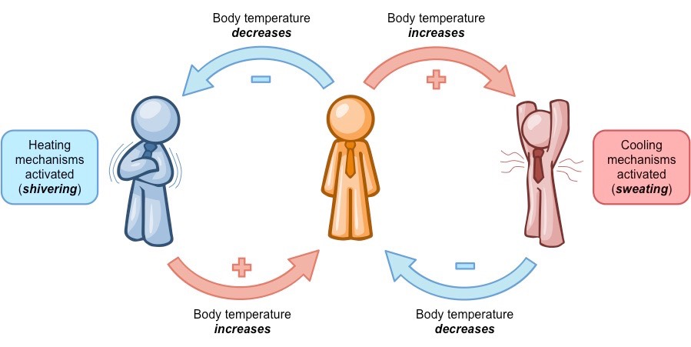
Feedback Loops
Homeostasis is maintained by feedback loops.

Slide 7
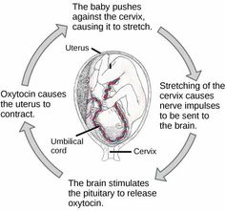
Positive Feedback Loop

Slide 8
Negative Feedback Loop

Slide 9
YouTube Homeostasis and Feedback Loops Amoeba Sisters

Slide 10
STOP HERE!

Slide 11
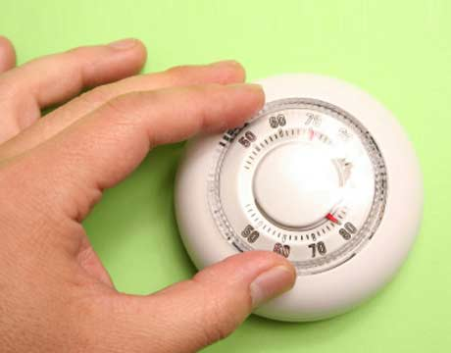
Homeostasis
The organ systems are working constantly to maintain a controlled, stable environment = Homeostasis.
Homeostasis in the body is maintained by feedback loops.

Slide 12
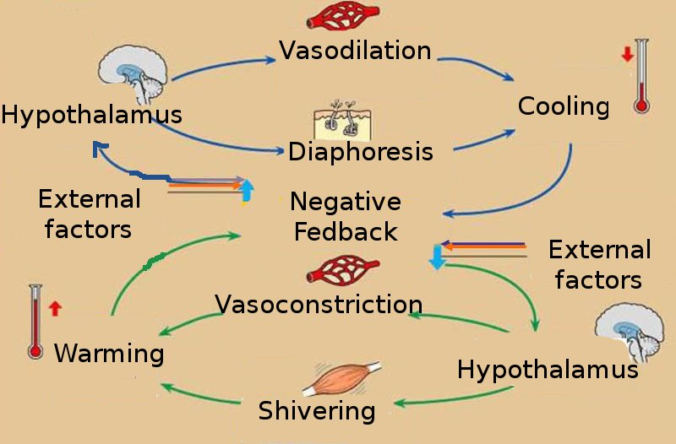
Feedback Loop
Positive and negative feedback

