Slide 1
Locard’s Principle of Exchange

Slide 2
Learning Objectives:
Locard’s Principle of Exchange
Define Trace Evidence, examples

Slide 3
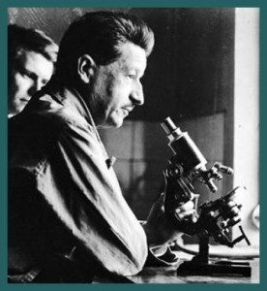
Edmond Locard
(1877 - 1966)
Father of Criminalistics
Built first forensics lab in France (1910)

Slide 4
Locard’s Principle #1
With contact between two items, there will be an exchange of material

Slide 5
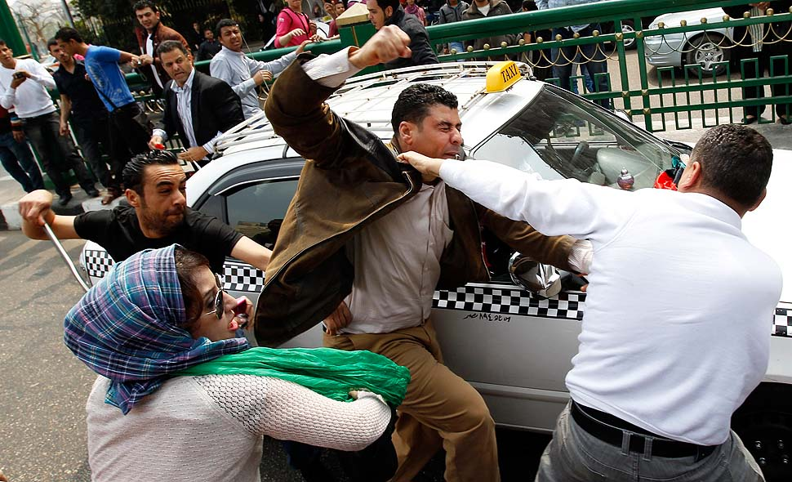
Locard’s Principle #2
vs
The intensity, duration and nature of the things in contact determine the extent of the transfer.

Slide 6
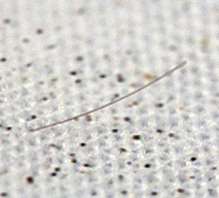
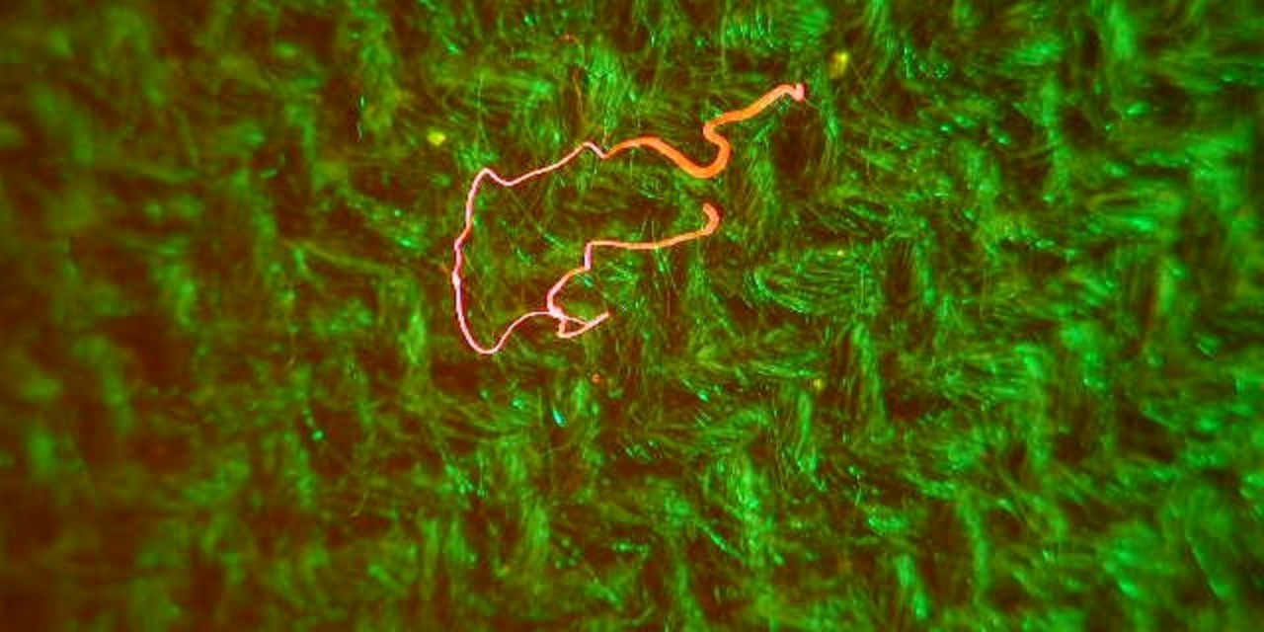
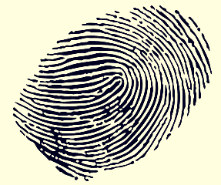
Trace Evidence
Small but measurable amounts of material found at a crime scene or on suspect

Slide 7
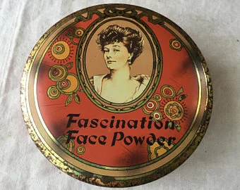
Example: The Case of Emile Gourbin
Suspect - Emile Gourbin, bank teller from Lyons, France.
Accused of killing girlfriend by strangulation. Had alibi.
Locard got scraping from under his fingernails. Found powder.
Powder identified as face powder that girlfriend used.
Emile confessed to the crime.

Slide 8
YouTube
The Original Sherlock Holmes

