Slide 1
Observation vs Inference

Slide 2
Learning Objectives
Explain the difference between an observation and an inference.
Describe the two types of observations.

Slide 3
What is an Observation?
Observation: the gathering of information using one or more of your five senses.

Slide 4
Two Types of Observations
Qualitative: describe what you observe
Quantitative: measure what you observe
The flower has white petals
The flower has 18 petals

Slide 5
What is an Inference?
This white flower is commonly used to make flower leis in Hawaii
Inference: an explanation for the observations that you have made which are based on your past experiences and prior knowledge.

Slide 6
Example 1
Observation: the grass on the front lawn is wet.
Inference: it rained
the sprinkler was on
the dog urinated on the grass!

Slide 7
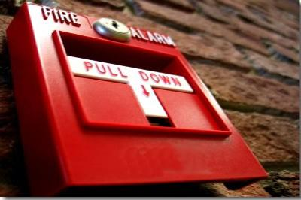
Example 2
Observation: the school fire alarm is ringing.
Possible inferences:
there is a fire at the school
this is a fire drill
a student pulled the fire alarm

Slide 8
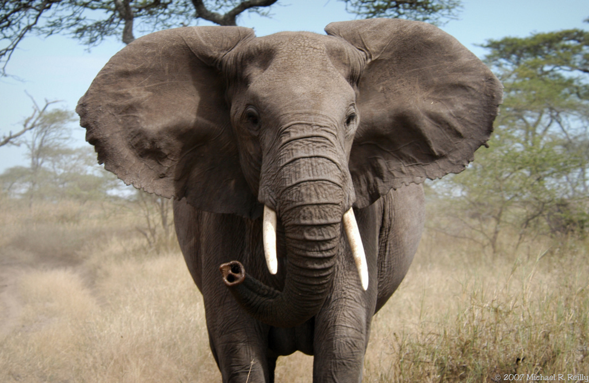
Example 3
Provide one observation and inference for the image above.

Slide 9
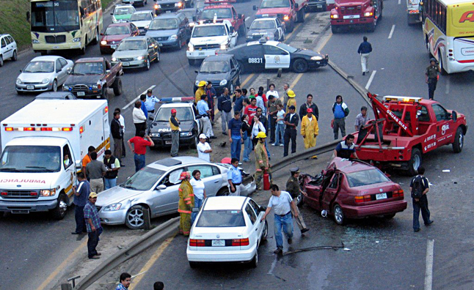
Example 4
Provide one observation and inference for the image above.

Slide 10
The End

