Slide 1
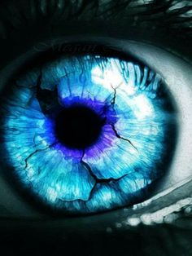
Structure and Function of the Eye

Slide 2
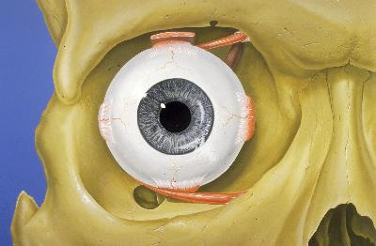
Eye Socket
Most of the eye is enclosed by a bony socket, which protects the eye.

Slide 3
YouTube Bug Eyes

Slide 4
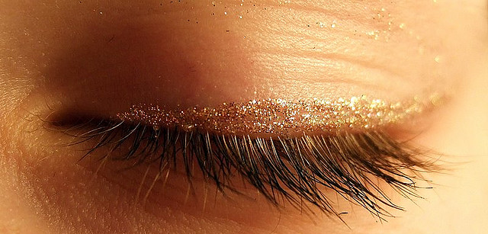
Eyelid
Thin fold of skin that covers the eye.
Functions to protect and lubricate the eye.

Slide 5
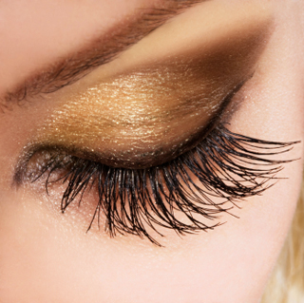
Eyelashes
Hairs that grow at the edge of eyelids
Filters out foreign matter

Slide 6
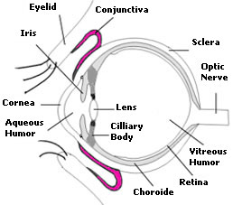
Conjunctiva
Clear lining of eyelids and surface of the eye
Secretes mucus to lubricate the eye

Slide 7
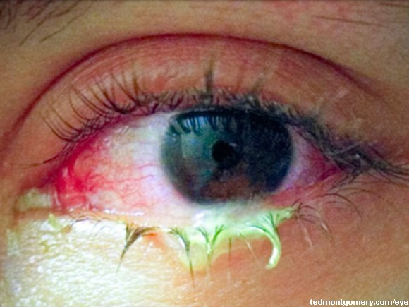
Conjunctivitis
AKA Pink Eye
Redness and inflammation of the conjunctiva caused by a bacterial or viral infection

Slide 8
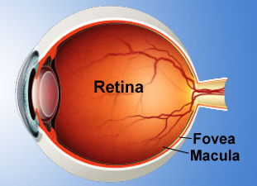
Retina
The innermost sensitive layer of the eye
Contains photo- receptors and neurons

Slide 9
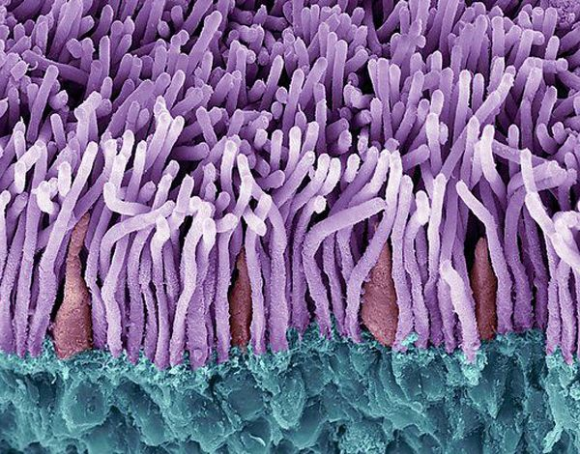
Photoreceptors
Rods
Cones

Slide 10
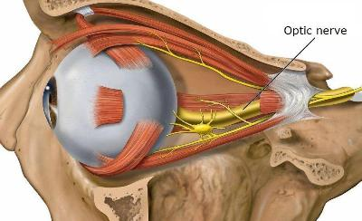
Optic Nerve
Nerves that carry visual messages from the retina to the brain

Slide 11
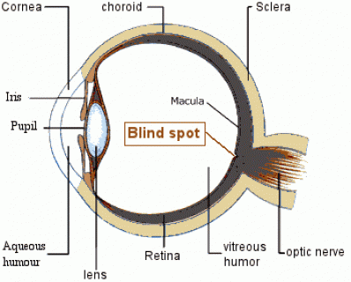
Blind Spot
The site where the optic nerve enters the retina
No rods or cones

Slide 12
YouTube Eyes

Slide 13
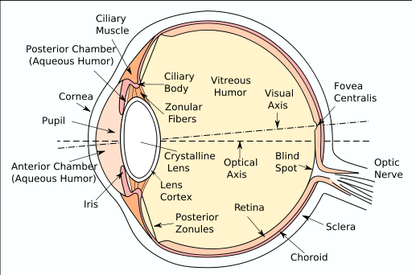

Slide 14
Stop Here

Slide 15
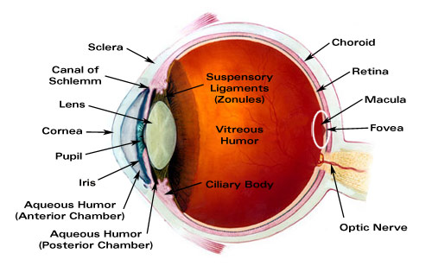

Slide 16
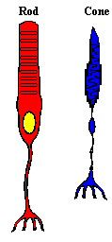
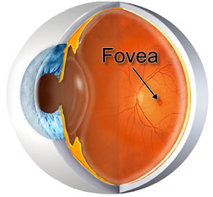
Rods
Important for dim light and peripheral vision
Present everywhere in retina except fovea

Slide 17
Cones
Sensitive to bright light
Clustered near the center of retina
Distinguishes color and allows for sharp vision

Slide 18
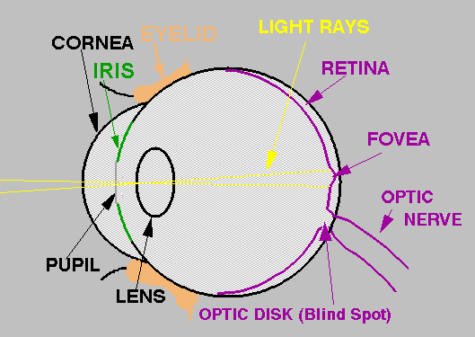
Fovea
A depression in the retina directly opposite the lens
Functions to form an extremely clear image

Slide 19
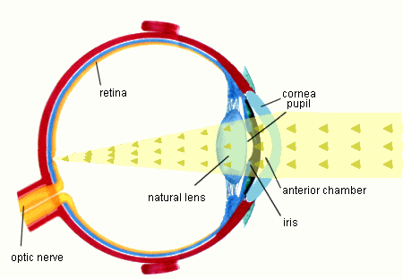
Workings of the Eye
Image enters through cornea, passes the pupil and falls on the lens
Lens converts light rays and inverts image
Optic nerve sends electrical signal to brain

