Slide 1
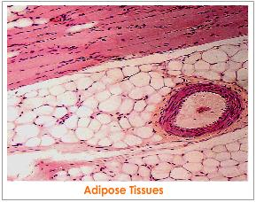
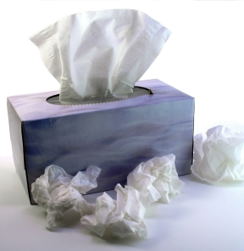
Types of Tissues

Slide 2
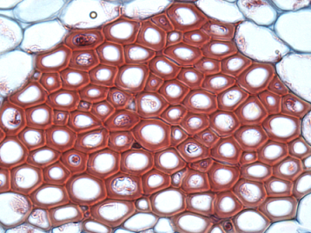
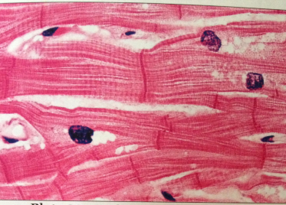
Tissue
Tissue - A group or mass of similar cells working together to perform common functions.

Slide 3
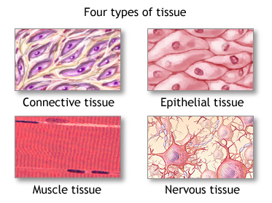
Review: Four Types of Tissue
Connective
Epithelial
Muscle
Nervous

Slide 4
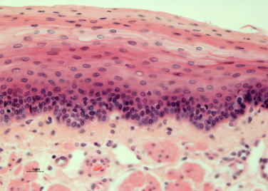
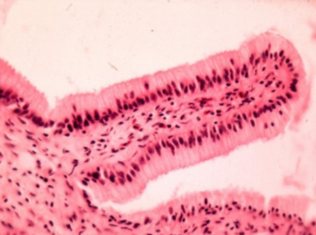
Epithelial Tissue
Skin
Small Intestine
Epithelial Tissue - covers all body surfaces, both inside and out.

Slide 5
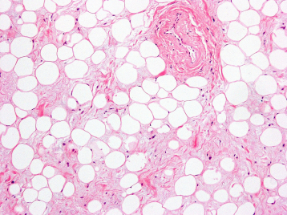
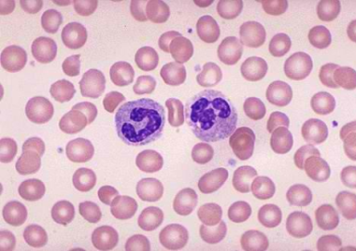
Connective Tissue
Adipose (fat)
Blood
Connective Tissue - Most abundant tissue, found everywhere. Provides support, protection, framework

Slide 6
Muscle Tissue
Muscle Tissue - plays a role in movement and heat generation to the organs.

Slide 7
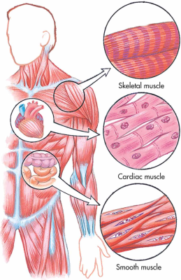
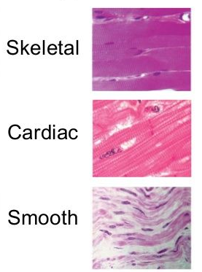
Types of Muscle Tissue

Slide 8
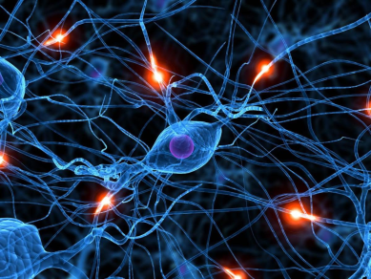
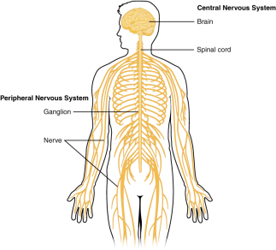
Nervous Tissue
Nervous Tissue - found in the brain, spinal cord and nerves. Coordinate & controls body functions

Slide 9
Stop Here

